Slide 1
Scenario - Internet still not working

Slide 2
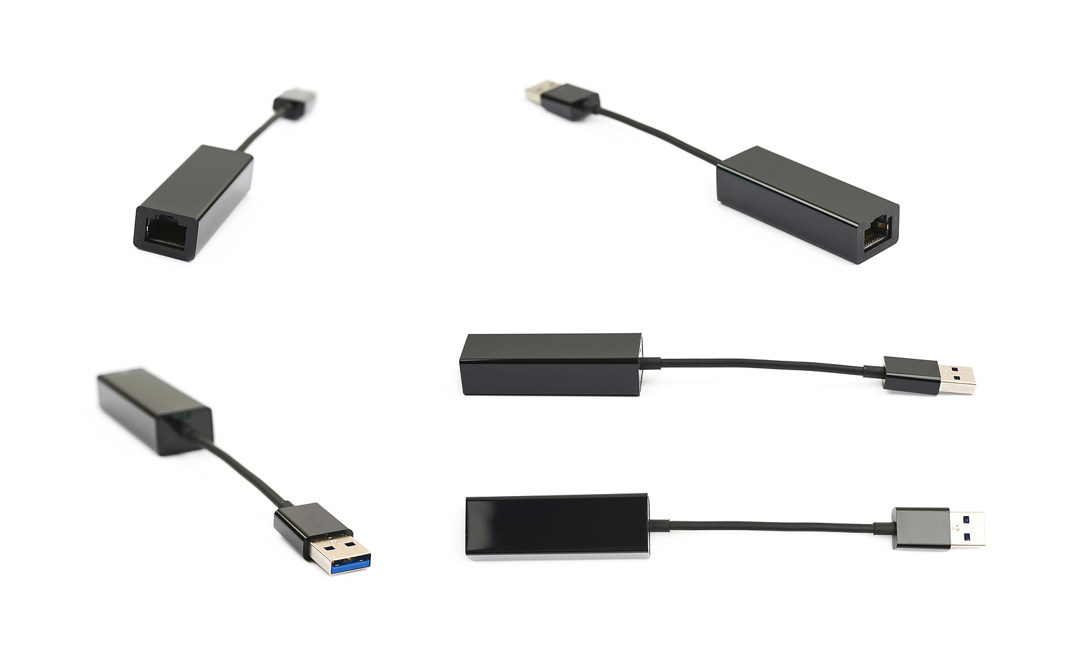
Initial Problem
John King says he was having trouble connected to WiFi so he bought a USB to Ethernet connector (pictured to the right). However, when plugging in the USB connector, it still does not connect to the internet.

Slide 3
Identifying the Problem
What questions do you have for John King?
You test his computer to make sure the USB to RJ45 dongle is not working
What information have you gathered?
Write this under the Identify the Problem section

Slide 4
Research
Researching “Insignia USB Ethernet connector not connecting” brings up the following:
The connector is hard to insert the ethernet cable, make sure this connection is solid
This product is not supported by MacOS
Drivers should automatically download
Unplugging and reinserting the hardware often fixes any issues
Product is very reliable and rarely runs into any issues
Have you tried restarting or updating the computer?
What are some theories?
Write these down in the Theory of Probable Cause section

Slide 5
Testing Theories
What theories would you like to test?
Did the theory work?
What happened when each theory was tested?
Unplug and Reinsert Dongle
Check Cables
Check Ethernet/Dongle Connection
Restart Computer
Test on a Different Computer
Test a new Cable
Test a new Connector
Check Drivers are Downloaded
Check OS Compatibility
Make sure the laptop’s battery is supplying enough power

Slide 6
Unplugging and reinserting
When the device is unplugged, the computer makes a noise to verify it has been unplugged
When reinserted, the computer makes a noise to verify it sees the device
However, there is still no network connectivity
Back to testing theories

Slide 7
Check cables
The ethernet cable is a CAT 6 cable that is connected to the ethernet port in the wall
The cable is inserted into the dongle
The dongle is connected to the USB port on the computer
Back to testing theories

Slide 8
Check solid connection
The cable is firmly inserted to the dongle
This should not be the problem, the connections are solid
Back to testing theories

Slide 9
Restart computer
The computer restarts
The computer still does not connect to the internet even with the dongle still connected
Back to testing theories

Slide 10
Test on different computer
You unplug the USB dongle from the computer and plug it into your computer
You notice you are connected to the internet, however wireless is still active
You turn off the wireless and notice that the internet is still connected and flowing through the USB to RJ45 dongle
Back to testing theories

Slide 11
Try a new cable
You replace the CAT 6 cable
It still does not connect the user’s computer to the network
Back to testing theories

Slide 12
Try a new USB to RJ45 Dongle
You replace the USB to RJ45 dongle
It still does not connect the user’s computer to the network
Back to testing theories

Slide 13
Check the OS
Using Windows 10
Connector works with Windows 10
Back to testing theories

Slide 14
Check Drivers were Downloaded
You check and notice the Drivers were not downloaded
Download and install drivers on that computer
Download and install drivers with a different computer
Back to testing theories

Slide 15
Install Drivers from Computer
Go to Insignia’s website and find the driver on a computer with a network connection
You notice you can not go to Insignia’s website because you are not connected to the internet
Download and install drivers with a different computer
Back to testing theories

Slide 16
Check Laptop’s Battery
The battery is working in great condition
You plugged in the battery to start charging it
Back to testing theories

Slide 17
Manually Install the Drivers (from another computer)
Go to Insignia’s website and find the driver on a computer with a network connection
Download the driver for the device
Move to a USB stick (or similar device)
Plug into the computer and install the driver
Fixed! The computer can connect to the network with the USB to RJ45 dongle

Slide 18
Document Findings
The system now works
In the Document Finding section, answer the following:
Why couldn’t the dongle connect the computer to the network?
How can a user check to see if this is their issue?
What are the steps to fix this issue?

